Slide 1
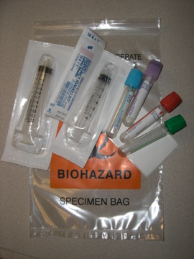
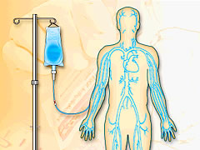
Before calling IV Therapy to draw labs……
Assess patient for phlebotomy or floor draw first
If you still need IV Therapy for a lab draw please have these items at the patient bedside BEFORE you page and include lab draw information with your page.
Lab tubes
Labels
Biohazard bag
6cc and 12cc empty syringes
Transfer device
THANKS!!!
September 2010 IV Therapy Tip of the Month

