Slide 2
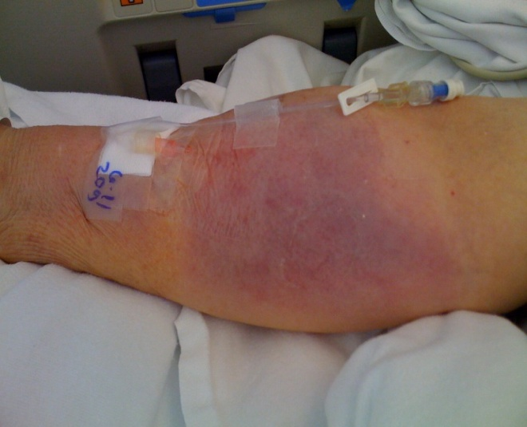
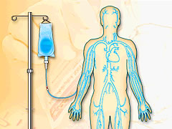
Is It better to have a bad IV than none at all?
NO!…Remember, “IF It’s Red It’s Dead…
If It’s Sore No More”?
Turn off the pump. Do not let IV fluid or medication continue infiltrating into the tissues. This will cause phlebitis, cellulitis or necrosis of the tissue.
Remove PIVs when:
Site is tender with infusions or IV push medications
Patient complains about IV site pain
PIV site swollen, red, tender
Leaking or drainage from site
Greater than 4days old
Do not wait for a new PIV to be placed.
Chart the phlebitis and infiltration scale in the doc flow and remove the PIV from the I&O LDA
November 2010 Tip of the Month

