Slide 1
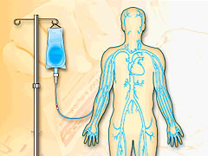
IV Therapy
Tip of The Month
Brought to you
by
The OHSU
IV Therapy Team

Slide 2
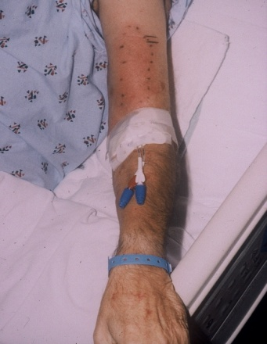
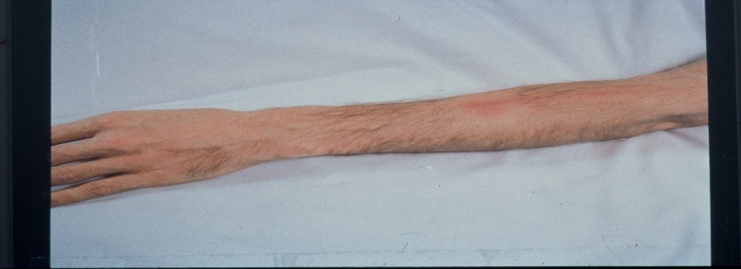
IV Therapy
October
Tip of the Month
“If it’s RED it’s DEAD”
“If it’s SORE….NO MORE”
Venous Phlebitis: Inflammation of the Vein
Signs and Symptoms
Pain with flushing or palpation of site
Edema
Erythema or red streak over vein
Palpable firmness of vein (strongly suggests
thrombophlebitis)
What To Do
For any or all of the above signs/symptoms, D/C the IV
Call the IV Team for questions

Slide 3



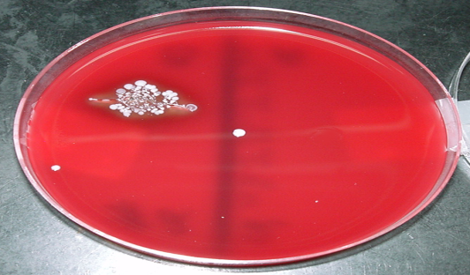
IV Therapy
November
Tip of the Month
Rub a dub dub, scrub that hub!
Scrub the HUB before you Flush!
Scrub the HUB for any IV/CVC access with pressure and friction for 15 seconds with alcohol and allow to dry.
Scrub entire hub tip, including luer lock and groves EVERYTIME you start a piggyback, give an IV push or anytime you need to access any CVC or PIV.
Firm rotating friction for 15 seconds and allow to dry
Culture Results:
Evidence of Valve Contamination
1 = No Alcohol Scrub
2 = Alcohol Scrub
1
2

Slide 4
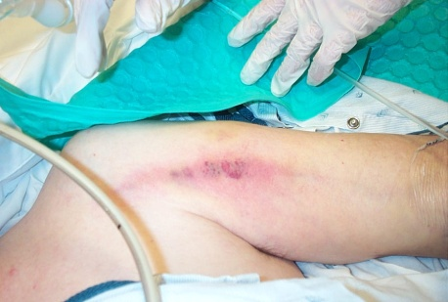
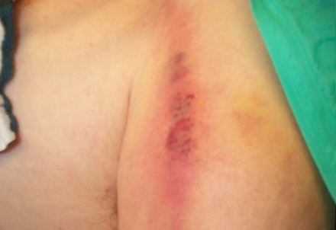
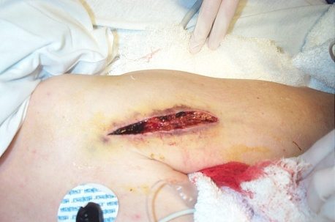
IV Therapy
December
Tip of the Month
“The Dilution Solution”
NEVER give undiluted Intravenous Promethazine (Phenergan)
Intravenous Promethazine (Phenergan)
Classified as a vesicant with pH 4 - 5.5
HIGHLY caustic
Institute for Safe Medication Practices Recommendations:
Use Lowest effective dose starting with 6.25mg
Dilute medication in at least 10 mL
Normal Saline
Administer through furthest port via
running IV over 10-15 minutes
STOP infusion if patient complains of pain or burning
Use LARGEST VEIN possible
Consider Alternative Treatment or different route (IM or po).
Significant Complications
Burning ? STOP !
Erythema
Nerve damage
Tissue necrosis
Phlebitis
Thrombophlebitis

Slide 5
Proactively
Advocate !
“DEFINE
IV Therapy
January
Tip of The Month
“DEFINE the use of the LINE”
Peripheral IV | PICC
Short Term Access | Greater than 5 day access
Non vesicant medications Primarily IV Fluid | Commonly used Vesicants: Vancomycin, Flagyl, KCL > 40 Meq….. Highly Irritating: Nafcillin, Cipro, Gentamycin ……
Great veins, minimal blood draws. | Difficult IV Access with overly used phlebotic veins. Admission diagnosis i.e. pancreatitis, ulcerative colitis, liver failure, joint infections, cellulitis.

Slide 6

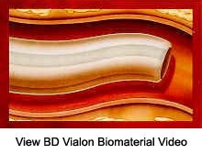
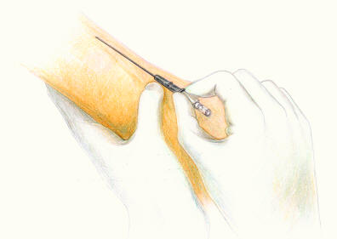
Prevent Mechanical
Phlebitis
IV Therapy
February
Tip of the Month
NO NEED to SUPER SIZE
Use the smallest IV catheter size needed for infusion
small
Gauge
Gauge | IV Fluid Only | Blood | IV Meds
24 Gauge (1200 mL/hr) | OK | OK | If only vein available
22 Gauge (2100 mL/hr) | OK | OK | BEST
20 Gauge (3900 mL/hr) | OK | Ideal | OK
18 Gauge (6600mL/hr) | For Large Volumes | OK | Avoid Routine Use
16 Gauge (13,200mL/hr) | Used when large volumes required but replace with smaller size ASAP.
USE YOUR
Best Clincial
Return from OR with 16 or 18 g?
Remove within 24 hours.
Judgement

Slide 7
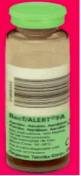
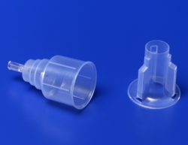

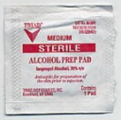
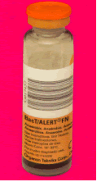
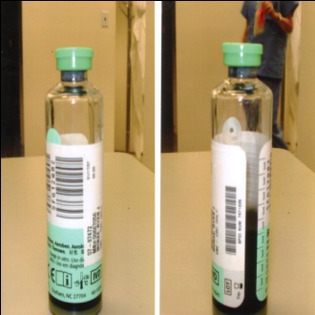
OHSU
Blood Culture
Contamination
Rate=
4-5%
IV Therapy
March
Tip of the Month
Changing the Culture
The method used to draw a blood culture affects the results
Green /Aerobic
With Oxygen
Fill first
10mL
Use
Chloraprep to decontaminate the skin
or hub and allow to dry.
Use Angel Wings to transfer blood to bottles
Limited Amount of blood?
Fill the aerobic first
Top of culture bottles are not sterile
Use Alcohol to disinfect after flipping off caps
Orange/Anaerobic
Without Oxygen
Fill Second
10mL
Contamination
Rate
Goal=1.5%
Proper
Label
Placement:
Stay away from
barcode
Developed by: OHSU IV Therapy and Lab Departments

Slide 8

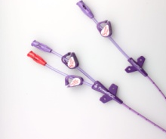
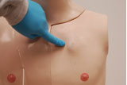
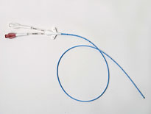
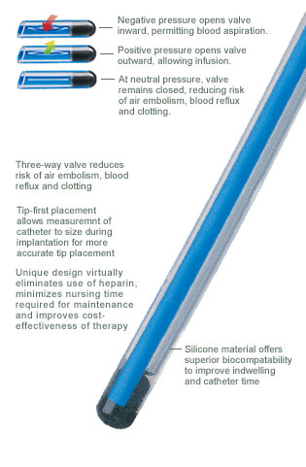
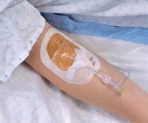
The Right
Flush In Time
Saves
The Line !
IV Therapy April
Tip of the Month
PICC, PORT & Midline FLUSHING: Flush every 8 hours and after each use
Doing a Blood Draw? Pulsatile Flush with 20 mL Normal Saline
Open Ended Power PICC (Purple) Or 4 French Dual Lumen (White) |  | Pulsatile Flush: 10mL Normal Saline and 3-5 mL 10u/mL Heparin Remove Syringe and Clamp Catheter Open Ended = No valve so keep it clamped !
Open Ended Port-a-Cath Common Use: Chemotherapy |  | Pulsatile Flush: 10mL Normal Saline followed with 3-5 mL 10u/mL Heparin Remove Syringe and Clamp Catheter Always use 100u/mL Heparin for deaccessing
Valved Groshong PICC (Blue) Common Use: Access for > 6 days of therapy |  | Pulsatile Flush: 10mL Normal Saline No Clamps Valved = Prevents Blood from backing up
Valved Midlines- Usually Groshongs |  | Pulsatile Flush: 10 mL Normal Saline May use 10u/mL Heparin to lock for frequent blood draws to prevent clotting Line Not Central/ Do not use vesicants Use: Short-term IV Therapy and blood draws
PICC
HEPARIN FLUSH
Date___________
Cm. Exposed_____
Initial_____
PAC
Heparin Flush
Date______
Size______
Initial______
PICC
SALINE FLUSH
Date___
Cm. Exposed_____
Initial_____Flush___
Line
NOT CENTRAL
Date___
Cm. Exposed_____
Initial_____ Flush__
*Refer to back of Vascular Access Device Flow Sheet: “Guidelines for Flushing” and for Pediatric flush amounts

Slide 9


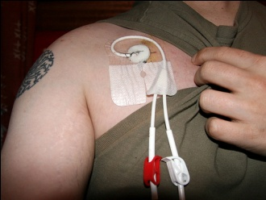
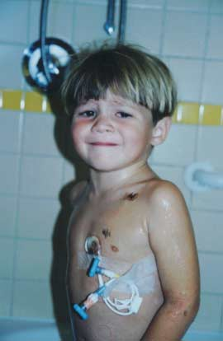
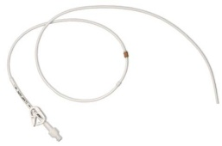
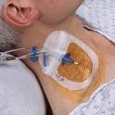
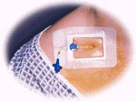
IV Therapy May
Tip of the Month
ALL Central Venous Line Flushes: Every 8 hours and after each use
Doing a Blood Draw? Pulsatile Flush with 20 mL Normal Saline
Chest Wall Groshong Usually Double Lumen Blue | Tunneled and cuffed Closed 10 mL Normal Saline Flush | Dressing for Tunneled Catheters: Semi-permeable transparent Dressing with or without Biopatch Change every 7 days and as needed. If using gauze, change every 48 hours and as needed
Chest Wall Hickman Catheter Usually Double Lumen White | Tunneled Comes out of the chest Open-ended (requires Heparin) 10mL Normal Saline Flush followed by 3-5 mL 10 Units/mL Heparin Lock
Internal Jugular Line Double, Triple, Quad Lumen | 10 mL pulsatile flush followed with 3-5 mL 10 units/mL Heparin Lock | Semi-permeable OCCLUSIVE Transparent dressing Change every 3 days and as needed.
Subclavian Line Double, Triple, Quad Lumen | 10 mL pulsatile flush followed with 3-5 mL 10units/mL Heparin Lock | Semi-permeable OCCLUSIVE Transparent dressing Change every 3 days and as needed
Groshong
(No Clamps = Closed !)
Hickman
(Has Clamps = Open !)
*Refer to back of Vascular Access Device Flow Sheet: “Guidelines for Flushing” and for Pediatric flush amounts

Slide 10
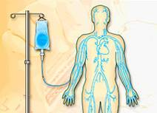
IV Therapy TIP of THE TIMES
SCRUBBING THE HUB for 15 seconds (not 3-5 seconds prevents transfer of microorganisms)
A very recent Study (2007) completed at Sharp Memorial in San Diego, Ca. found that friction for 15 seconds with either 70% alcohol alone or Chloraprep provided effective disinfection.
Disinfection of the HUBS with 70% alcohol for 3-5 seconds is not effective in preventing transfer of microorganisms.
Proper disinfection of the HUB is an important strategy to prevent Catheter-Related Blood Stream Infections.
NEW !!
Evidenced Based
Practice Change

Slide 11
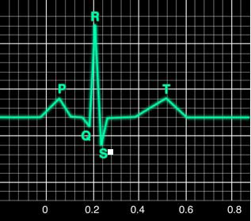


IV Therapy
June
Tip of the Month
That PICC Line may be your patient’s LIFE Line
Case Review: 56 Year Old White Male transferred from outlying hospital with Diabetes, Crohn’s Disease and partial removal of small intestine for multiple fistulas. PICC line in left antecubital placed by another facility. No physician order or CXR confirmed placement. PICC Line used to infuse TPN/Lipids. On Day # 2 patient complained of pain in the left arm and assessment revealed edema with redness in the left shoulder area. CXR indicated line was not central but in fact midline with subsequent thrombus, and severe phlebitis (see pictures below)
1.) What should you do if your patient is a transfer from an outside facility ?
  Obtain PICC Tip placement CXR (Recommended for new patients to OHSU)
  Assure you have a a physician order prior to line use
  Promptly notify IV Therapy of admission and change the hubs
2.) What about when your PICC patient transfers between units ?
  Promptly notify IV Therapy
3.) Is your patient going home with a PICC?
  Notify IV Therapy
4.) PICC line discontinued?
  Do not call the PICC pager, call your IV Team pager
3 Days After Thrombus Removal

Slide 12
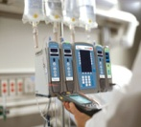
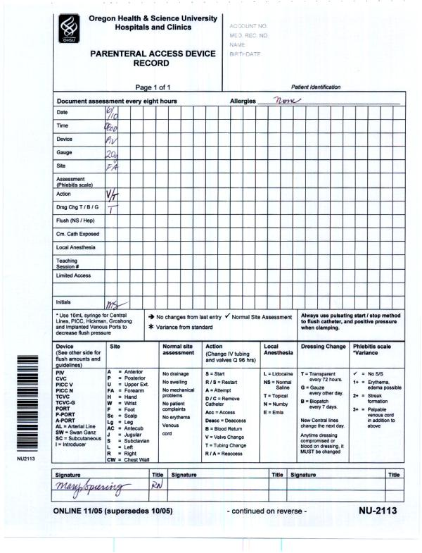


Change
IV Tubing and Valves
How Often?
IV Therapy
July
Tip of the Month
Change Primary and Secondary IV Tubing every 96 hours and TPN Tubing every 24 hours
Change Valves every 96 hours
Document “T” and “V” on the Parenteral Access Record when changed.
Change out stopcocks as soon as possible and try to avoid using them (Why? CDC indicates they become contaminated at least 50% of the time they are used)

Slide 13
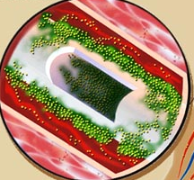

Biofilm
The start of a Central Venous Catheter Infection.
IV Therapy
August
Tip of the Month
PREVENT Biofilm Formation
Biofilm: microorganisms that attach to the surface of a catheter (both inside and out) and resist antibiotics.
Instead of just flushing with a steady flow…Use Pulsatile Flushing for ALL Central Lines
PUSH STOP PUSH STOP
Pulsatile Motion Creates
Turbulent Flow
Turbulent flow reduces catheter residue on the inner surface of the catheter and prevents clot and fibrin formation.
Intra-luminal biofilm

Slide 14
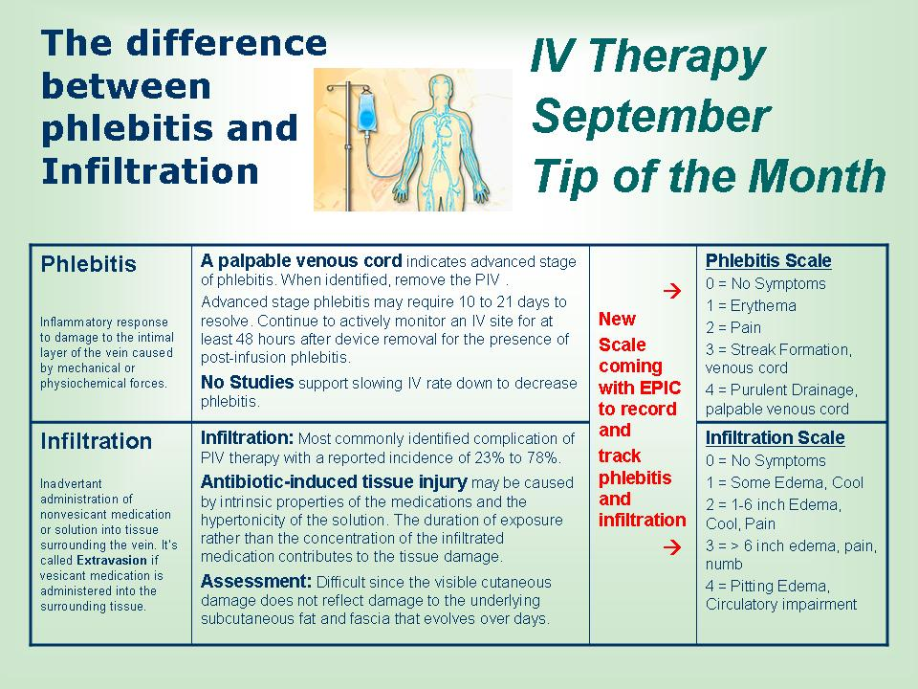
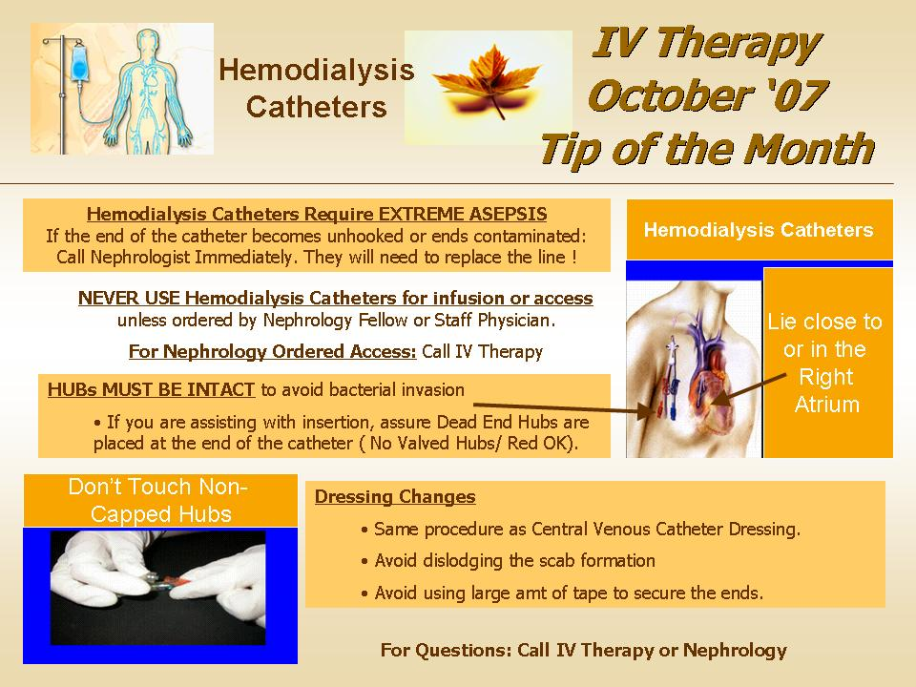
Paging the IV Team
Include This Information When You Page
  Unit/Area you are calling from
  Call Back Number
  Patient Room Number
  Patient Name
  What the patient needs (IV line, PICC line dressing, Port Access)
  Why (if applicable)
When To Page The IV Team
  Questions about ANY/ ALL LINES
  IV Access and IV Placement
  Patient admitted with PICC and for all PICC dressing changes
  TPA repairs
  Phlebitis
PICC LINE PAGER IS FOR PLACEMENT ONLY
  Page 12298
  (Not for dressing changes or evaluations)

