Slide 1
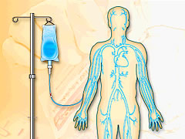
JOIN TODAY
IV Therapy
January,‘08
Tip of the Month
No matter what the occasion, SCRUB the catheter ports every single time before access.
Evidence Supports SCRUBBING using pressure and friction for 15 seconds with alcohol and allow to dry.*
*Kaler, Wendy; Chinn, Raymond (2007) Successful Disinfection of Needleless Access Ports: A Matter of Time and Friction. Journal of the Association for Vascular Access, Volume 12, Number 3, pp. 140-142
Every Hub Every Time
Every Hub Every Time
OHSU Scrub The Hub Campaign
© OHSU IV Therapy Team.
Contact: Spiering@ohsu.edu

Slide 2
IV Therapy
February,‘08
Tip of the Month
New Line
New Tubing
All Newly Placed
Central Venous
Access Lines
(CVC, PICC, Hickman, and Port)
Absolutely Require NEW
Infusion Bags and Tubing.
In cases of emergent Central Venous Access replacement
Old infusions can be switched to new central line without new bags/tubing.
The old infusions should be replaced with new infusions and tubing as soon as the patient is stable.
OHSU Policy: Continuous Infusion Bag
And tubing change With Central Line
Replacement
Effective Date: February 01, 2006
Prevent Central Venous Access Bloodstream Infections
© OHSU IV Therapy Team.
Contact: Spiering@ohsu.edu

Slide 3
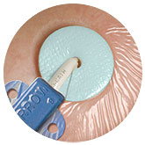
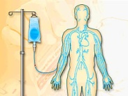
IV Therapy
March Tip of The Month
BIOPATCH
®
New Central Venous Access Dressing Change Requirements:
Once every seven
days with Biopatch
unless integrity of the dressing is compromised.
New central venous dressing kits coming also !
BIOPATCH® Protective Disk has been found to reduce the incidence of CRBSI and local infections.
Use BIOPATCH with Central Venous Catheters*
Watch for brief unit inservices in March
* Exclude patients with Chlorhexidine sensitivity
IMPORTANT: Read Tip of The Month e-mail.
© OHSU IV Therapy Team.
Contact: Spiering@ohsu.edu

Slide 5
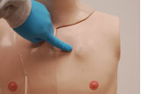
“Nobody checked and nobody asked”
IV Therapy
May,‘08
Tip of the Month
Does your patient have a Portacath?
Upon admission
Ask patient or family member if Portacath present.
Assess chest for any vascular access
Palpate chest for implanted port
Take a look at patient history, especially if they have a chronic illness
Look at the CXR
If they have a port, obtain order for access from provider
Page your IV Therapy Team for access
Remember to Check and Ask
Your patient may already have a port….check and ask to
save your patient unnecessary line placements and additional costs.

Slide 6
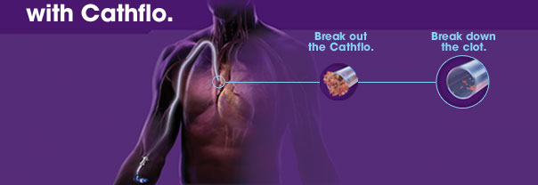
No Flush
No Flow
IV Therapy
June , 2008
Tip of the Month
Keep PICC lines flowing…
~Flush~
Flush To Prevent Occlusion
Avoid this
Open the flow
Prevent vascular access infection and occlusion.
Flush every eight hours using pulsatile flush
Open Ended PICC Flush (Such as a Power PICC)
Adult: 10 mL NS pulsatile flush followed with 3-5 mL 10 units/mL Heparin
Peds: 5-10 mL NS pulsatile flush followed with 3-5 mL 10 units/mL Heparin
Every 8 hrs and after each use
Reminder
Heparin will not dissolve existing clots
Pulsatile flush each lumen with 10 mL Normal Saline first, then instill 3-5 mL 10 units/mL Heparin.
© OHSU IV Therapy Team.
Contact: Spiering@ohsu.edu
Notes:
6

Slide 7
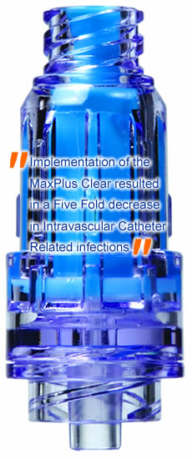
IV Therapy July
Tip of The Month
A Clear View
coming to you soon…
MaxPlus Clear
Hub Facts
Hubs are easily contaminated when they touch the skin.
If hubs are not disinfected the contaminate can infuse into the valve and patient.
Residual blood in the hub serve as a media for infection.
Clear hubs allows you to see residual blood and drug incompatibility precipitant in the hub so you can replace them and decrease the risk of Catheter Associated Blood Stream Infection.
Reference: Royer, Tim et al(2007) A Five-Fold Decrease of Intravascular Catheter Associated Blood Stream Infections: Clearly Beyond the Central Line Bundle
Brief 5 minute
inservices
on your unit
the week of July 23rd
Max-Plus Clear Valves/Hub Quick List
Wash your hands prior to touching any part of the hub.
Invert the MaxPlus Clear and prime before attaching to end of a catheter or tubing.
“Scrub the Hub” with friction for 15 seconds prior to entry.
Replace the MaxPlus Clear After blood draws/administration or if blood residue is present in the valve.
Flush through the hub with 10mL Normal Saline (Use Heparin per flush protocol) and assure hub is clear of all blood residue.
When clamping a line, only clamp after flush is complete and you have disconnected from MaxPlus Clear. This ensures blood is cleared from the end of the catheter.
From Opaque
To Clear

Slide 8
Central Venous Catheter
Occlusion
IV Therapy August
Tip of The Month
Immediate Action Required
First
Assess for external mechanical obstructions(all which can contribute to catheter clotting)
IV tubing clamped?
Pump off ?
Infusion set empty?
Patient position cause kinking?
Dressing wet due to break or hole in catheter.
For Ports: Check Huber needle placement
Then
Assess for internal obstruction
Remove and inspect valves & tubing
Place 10mL Normal Saline syringe to hub
Attempt to Withdraw 1st and assess for blood return. Able to infuse? Sluggish? Completely occluded?
Assess EACH LUMEN separately
Never leave one clotted lumen
Reference: Nakazawa, Nadine (2008) Managing Catheter Occlusions with Cathflo. Presentation
After full inspection and confirmation of a catheter occlusion, call IV Therapy and report your findings
Catheter Occlusion = Risk of infection and venous thrombosis
Notes:
8

Slide 9
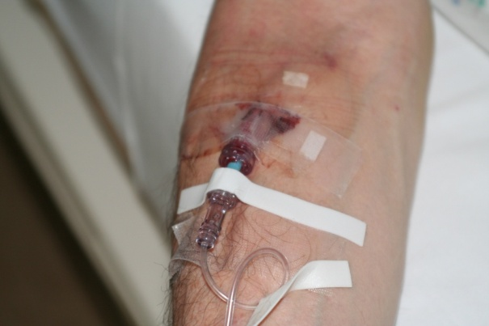
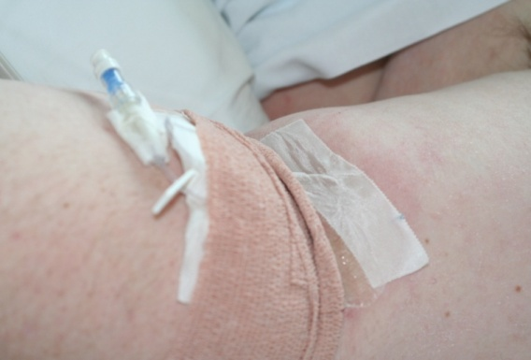
Avoid Complications, STOP the infusion!
IV THERAPY SEPTEMBER
TIP OF THE MONTH
“IF IT’S RED IT’S DEAD
IF IT’S SORE….NO MORE”
Phlebitis or Inflammation of the Vein
Pain with flushing or palpation of site
Edema
Erythema or red streak over vein
Palpable firmness of vein
Phlebitis Suspected?
DISCONTINUE INFUSION !
Remove Catheter
Disinfect venipuncture site
Apply pressure at removal site to prevent bleeding
Elevate extremity
Apply intermittent warm, moist heat for 20 min. 3-4 times per day.
© OHSU IV Therapy Team.
Contact: Spiering@ohsu.edu

