Slide 1
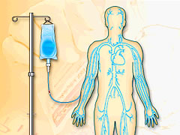
Is The PICC Ok To Use?
The process for deciding if a PICC line is OK to use depends on where it was placed.
New PICC placement at OHSU
CXR performed after placement
“OK to use PICC” order comes from PICC team RN
Patient’s PICC is automatically added to the work list for IV team
Patient admitted to OHSU with PICC
Admitting RN notifies IV team via pager to assess PICC and add dressing change to IV team work list
Admitting RN alerts MD.
MD determines if CXR is necessary
Is a CXR necessary?
CXR is performed.
MD reads CXR.
MD gives “OK to use PICC” order
MD gives “OK to use PICC” order
Note: Discrepancies or placement issues after initial PICC RN reading need to be directed to the attending MD
YES
NO
© OHSU IV Therapy Team.
June 2010

