Slide 1
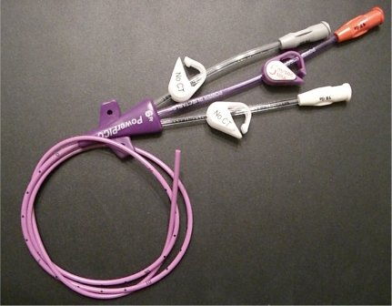
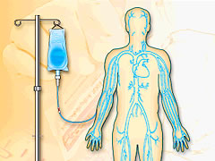
Power PICCs Changes to the MAR
Power PICCs with Continuous Infusion:
Pulsatile flush Q 8hrs with NS
Power PICCs Used Intermittently:
Pulsatile flush Q 8hrs with NS followed by 10 unit/ml heparin flush (see OHSU flushing guidelines for appropriate volumes)
good catheter management with regular pulsatile flushes improves patency and decreases the need for t-PA
Power PICCs now have two orders for heparin:
10 unit/ml heparin flush PRN
10 unit/ml heparin flush Q8hrs
BARD IFU, Cathflo IFU
IV Therapy 2011

